Slide 1
CRM OVERVIEW
AFFIX
TRANSITION / ONBOARDING DOCUMENTATION

Slide 2
Touch Points
Systems that send outgoing messages

Slide 3
Iterable
Outgoing Marketing Messages

Slide 4
SendGrid
Usage:
Marketing Automation / Marketing Messaging
Notes:
There are four projects in Iterable:
Verifly – currently the main instance, connected to production environment
Verifly – Sandbox (connected to the staging environment)
Verifly – Live (not currently connected, intention would be to only port sound data from production)
Verifly – Dev (used by the dev team for testing)
Credentials:
Main User: chris@verifly.com / pass: V3r1fly!
Super User Backup: hi@verifly.com / pass: V3r1fly!

Slide 5
Iterable
Iterable is the primary means by which Verifly reaches contacts with Marketing Messaging. It is a Marketing Automation Platform (Not actually a CRM) that enables multichannel touchpoints. These include Email, In-App, SMS, and Push Notifications.
Here is a copy of the initial launch plan and Iterable plan

Slide 6
Iterable
Currently Iterable is largely used to send emails despite its additionally capabilities. Although SMS, Mobile Push, and In-App were set up in late Q2 2019.
As such the Iterable instance was initially set up to optimize around the limitation of only having email as a distribution medium. Accordingly, there are a handful of distribution flows:
Nurture Program – Quote Abandonment Journey | Q2 2019: 3 Emails
Nurture Program – Customer Journey | Q1 2019: 5 Emails
Nurture Program – Quote Lead Journey | Q1 2019: 6 Emails
Nurture Program – Customer Journey / Extension (Policy Expired) | Q2 2019: 1 Email
Blog Confirmation Workflow: 1 Email
[User Engagement / Breakpoint]: 1 Email

Slide 7
Iterable
LTV Focused Workflows
The following workflows are concerned with the customer journey and were/are aimed at increasing LTV. Each journey from the top-down leads to the next in terms of the Lead Funnel.
On the next slide is a breakdown of how these workflows work together
Nurture Program – Quote Abandonment Journey | Q2 2019
Nurture Program – Quote Lead Journey | Q1 2019
Nurture Program – Customer Journey | Q1 2019
Nurture Program – Customer Journey / Extension (Policy Expired) | Q2 2019

Slide 8
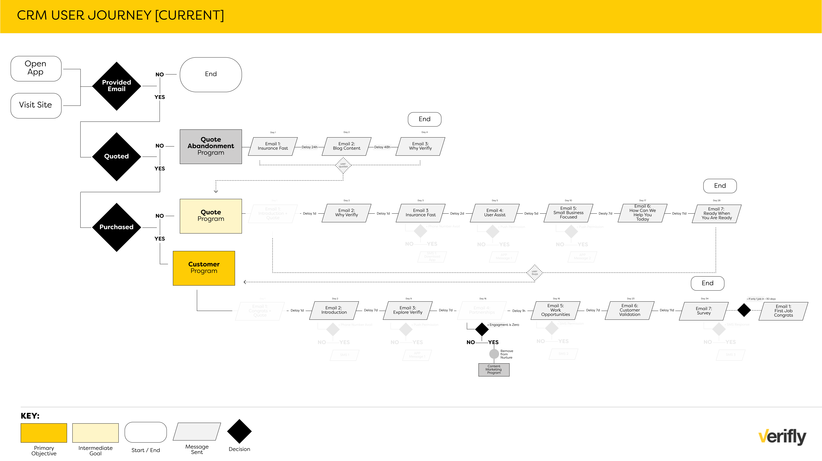
Iterable

Slide 9
Iterable
Engagement Focused Workflows
These journeys are concerned with amplifying content and / or showing care fore our customers. The blog confirmation is only triggered when a user actively subscribes to the blog.
While the Breakpoint user engagement flow is sent when a user purchases their third policy
Blog Confirmation Workflow
User Engagement / Breakpoint

Slide 10
Iterable
Recurring Blog Send
The weekly blog email that was set up in Iterable was set up to pull data from the Blog, Facebook, and Twitter using Data Feeds to aid in content amplification goals. It was scheduled to go out every Thursday after 6pm.
However, it has been paused as of 7/31/19 so that the process and strategy can be reassessed
Weekly Blog Email
QA Version of Weekly Blog
Data Feeds used in above templates

Slide 11
Iterable
Other Workflows
There are 20 total workflows in Iterable. Beyond the 6 that are covered in the prior slides the other 14 are used for tracking, segmentation, and analysis purposes. A break down of those workflows can be seen here

Slide 12
Iterable
Templates
There are 56 Templates in Iterable. However, only 21 of them are actively used for campaigns; which, can be seen here (The dates of there creation range from 2-4 months. The other templates were not deleted as they may give perspective as to efforts prior to Jan 21. Additionally, Templates cannot be archived

Slide 13
Iterable
Snippets
There are a handful of snippets that are used to generate emails in Iterable.
*interstial_depricated
interstitial_update
markup_close
body
content
secondary_main
interstitial
footer
head
style
header

Slide 14
Iterable
User Fields
User fields are the data points that are directly connected to a user. It is distinct from a Custom Event in that it’s a signal piece of data that can be used for analysis, and paired against all users via export.
The basis for the fields can be seen via the following documents examples use here (Fields starting with ‘Z*’ are custom fields that only exist in Iterable):
https://verifly-my.sharepoint.com/:x:/p/chris/ESX5p5W-x89EpNy_c4EdbjsBdd5TQh_23MTeMISQoAlBhA?e=iV8j6Z
https://docs.google.com/spreadsheets/d/10awQZeprn6CoUlNglwIqUyqX9le_jcRDL0sE4UZiVnw/edit#gid=53530248
https://support.iterable.com/hc/en-us/articles/206430145-Contact-properties

Slide 15
Iterable
Custom Events
Custom Events are similar to User Fields however it is oriented more towards the event rather than the user. For example, an event can be triggered anytime a user ”Buys a policy” and a JSON call. However, the ‘data’ for that event can only be seen on the User level Events tab within Iterable
Technically, a Custom Event can be used to update user fields however; this must largely be managed by the dev team.
Additionally, Custom Events are a bit more cumbersome to evaluate if the data is sound owing to the way it is organized.
https://sketch.cloud/s/1eYOb / https://sketch.cloud/s/8AZwY

Slide 16
Reporting
Iterable
Here are the ways to analyze data in Iterable:
Create A Dashboard (https://iterable.com/blog/introducing-iterable-insights/)
Run A Report (https://support.iterable.com/hc/en-us/sections/201118025-Analytics-and-Reporting)
Data Sources
There are two primary ways to get data in/out of Iterable.
The Data Science point owns how these work.
Integration with Segment
Data feed from Looker

Slide 17
Key Documents
Iterable
Iterable Onboarding Deck:
https://docs.google.com/presentation/d/1R5Hp8PZbETYxxz2QlaMhwSFMJ8UxhfYKmggGBLG3s0k/edit#slide=id.p33
Iterable Planning Doc:
https://docs.google.com/presentation/d/1ulj7jf6dMS1vG8wJIvWHhipjYeTC-rgudCXKE1WFG-o/edit#slide=id.g3cfe6a73a8_2_1077
Iterable Planning Doc:
https://docs.google.com/presentation/d/1ulj7jf6dMS1vG8wJIvWHhipjYeTC-rgudCXKE1WFG-o/edit#slide=id.g3cfe6a73a8_2_1077
Segment-Iterable Doc:
https://www.processon.com/view/link/5d084eb9e4b024123dde5a5f

Slide 18
Best Practices and FYI
Iterable
CRM Best Practices
https://www.salesforce.com/crm/best-practices/
https://www.cio.com/article/3085630/11-crm-best-practices.html
https://keap.com/product/crm-best-practices
4P’s of Marketing (Product, Price, Placement, Promotion)
https://blog.capterra.com/understanding-the-marketing-mix-the-4-ps-of-marketing/
Email Benchmarks by Industry
https://mailchimp.com/resources/email-marketing-benchmarks/
https://www.campaignmonitor.com/resources/guides/email-marketing-benchmarks/
https://www.smartinsights.com/email-marketing/email-communications-strategy/statistics-sources-for-email-marketing/

Slide 19
SendGrid
Outgoing Marketing Messages

Slide 20
SendGrid
Usage:
Transactional Emails
Notes:
There are two instance of Sendgrid. One used for Producation, the other used for Staging. Additionally there will likely be a third instance used for Broker outreach
Credentials:
PRODUCTION ENVIRONMENT | email: hi@verifly.com / username: verifly.marketing / pass: V3r1fly01!
STAGING ENVIRONMENT | email: sendgridtest@verifly.com / username: veriflytest/ pass: Special!441g

Slide 21
SendGrid
SendGrid is the tool that is used to send Transactional Emails to Contacts. Most of the Transactional Emails go to customers and additional insureds to notify them of events related to their respective policies.

Slide 22
SendGrid
Note: the there are two instances of SendGrid. One for testing that is connected to Staging / Beta and the other that is connected to Production / Live. When updating emails with functional changes it is recommended that updates take place and are tested in the staging instance and then copied over to the production instance.

Slide 23
SendGrid
As followed are the 28 templates that are used in SendGrid:
(the html versions of these files can be accessed here [Transactional Templates.zip])
Policy-Amend
*Broker-sign-up-invite
*Agent-sign-in-notification
*Agent-create-password-notification
Demo
Policy
Policy-cancel
Prebook-cancel
Ai-policy-extend
Ai-policy-update-ai
Reset-password
Ai-policy
Prebook-reminder
Ai-prebook-cancel
Policy-new-ai
Policy-update-insured
Forwarded
Ai-policy-amend
Ai-policy-update-insured
Ai-policy-new-ai
First-purchase-widget
Invite
Policy-extend
Prebook-confirm
Prebook-new-ai
Ai-policy-cancel
Policy-expire-reminder
Purchase-receipt
*associated with the Broker Campain

Slide 24
Yotpo
Outgoing Marketing Messages

Slide 25
Yotpo
Usage:
Used to garner outward facing review for customer assessment and review
Notes:
This tool has been
Credentials:
hi@verifly.com / V3rifly!

Slide 26
Delighted
Net Promoter Score (NPS) Software

Slide 27
Delighted
Usage:
Used to garner inward facing customer review NPS evaluation
Notes:
This is live and currently is sent to customers 3 days after their first purchase
Credentials:
hi@verifly.com / V3r1fly!

Slide 28
Typeform
Surveys & Polls

Slide 29
TypeForm
Usage:
Used for additional user feedback not related to Yotpo / Delighted
Notes:
There were two initiaves involving the use of Typeform (Quoter Survey – to see why people didn’t buy & Customer Survey – to better understand the customer journey and purchasing decisions
Credentials:
hi@verifly.com / V3r1fly!

Slide 30
Webflow
Landing Pages & Subscription Center

Slide 31
Webflow
Usage:
This was originally used to create the Subscription Center. It is still active, but is not being used / driven to currently. It was also acquired as a best practice is to have single use landing pages to be separated from the main landing page instance.
Notes:
This is not currently being used for any projects, but can be useful for future landing page tests
Credentials:
hi@verifly.com / V3r1fly!

Slide 32
Reply.io & Prospect.io
Broker Campaign Tools / ESP

Slide 33
Reply.io / Prospect.io
Usages:
For prospecting outreach to brokers as part of business Development
Notes:
Dave Bixler is lead on these tools
Credentials:
See above

Slide 34
Outstanding Projects
Next Steps

Slide 35
Transactional Update
Updating the templates that exist in SendGrid
---
As referenced under the SendGrid section all of the Transaction templates were updated to reflect UX design.
Can be accessed here or here

Slide 36
CRM Update & Redesign
Changing content in Iterable to reflect brand updates and to better support current company objectives

Slide 37
Auxilary Processes
Other tangential tools / actions related to CRM

Slide 38
Litmus
Email Quality Assurance [QA] Software

Slide 39
Litmus
Usage:
Litmus is used to QA all outgoing email templates.
Notes:
A record of all the renders of all templates can be seen here.
There is also a record of email tracking which provides inbox info such as clients and time spent in email that can be seen here.
Credentials:
hi@verifly.com / V3r1fly!ds

Slide 40
Zapier
Systems Integration

Slide 41
Zapier
Usage:
Used to set up and test initial workflows / integrations. However, was deprecated to only be used to automated the unsub request that come through FreshDesk / email responses
Notes:
Any user that goes through this associated zap gets triggered in Iterable and flagged as ”fresh desk” and are suppressed and unsubscribed from Emails, they are marked as unsub in FreshDesk, and a ping is sent to Slack so that marketing is aware of these set of events
Credentials:
hi@verifly.com / V3r1fly!

Slide 42
Recommendations
Moving forward with CRM

Slide 43
CRM Engine
Recommendations
Recommendation on moving away from Iterable as the CRM / Marketing Automation platform; the contract renews around Dec 2019 /Jan 2020

Slide 44
Recommendations
Braze
Best in class option; more expensive but easier to use with all the same marketing channels as Iterable
https://www.braze.com/product/
Drip
Slightly lesser version of Braze, may be more suitable for current state of Verifly as a marketing automation solution
https://www.drip.com/features
Active Campaign
More traditional marketing automation platform with some CRM capabilities. Could be used to evaluate moving towards a marketing stack rather than an all-in-one solution
https://www.activecampaign.com/pricing/

Slide 45
Key Terms
AFFIX
Things to Know

Slide 46
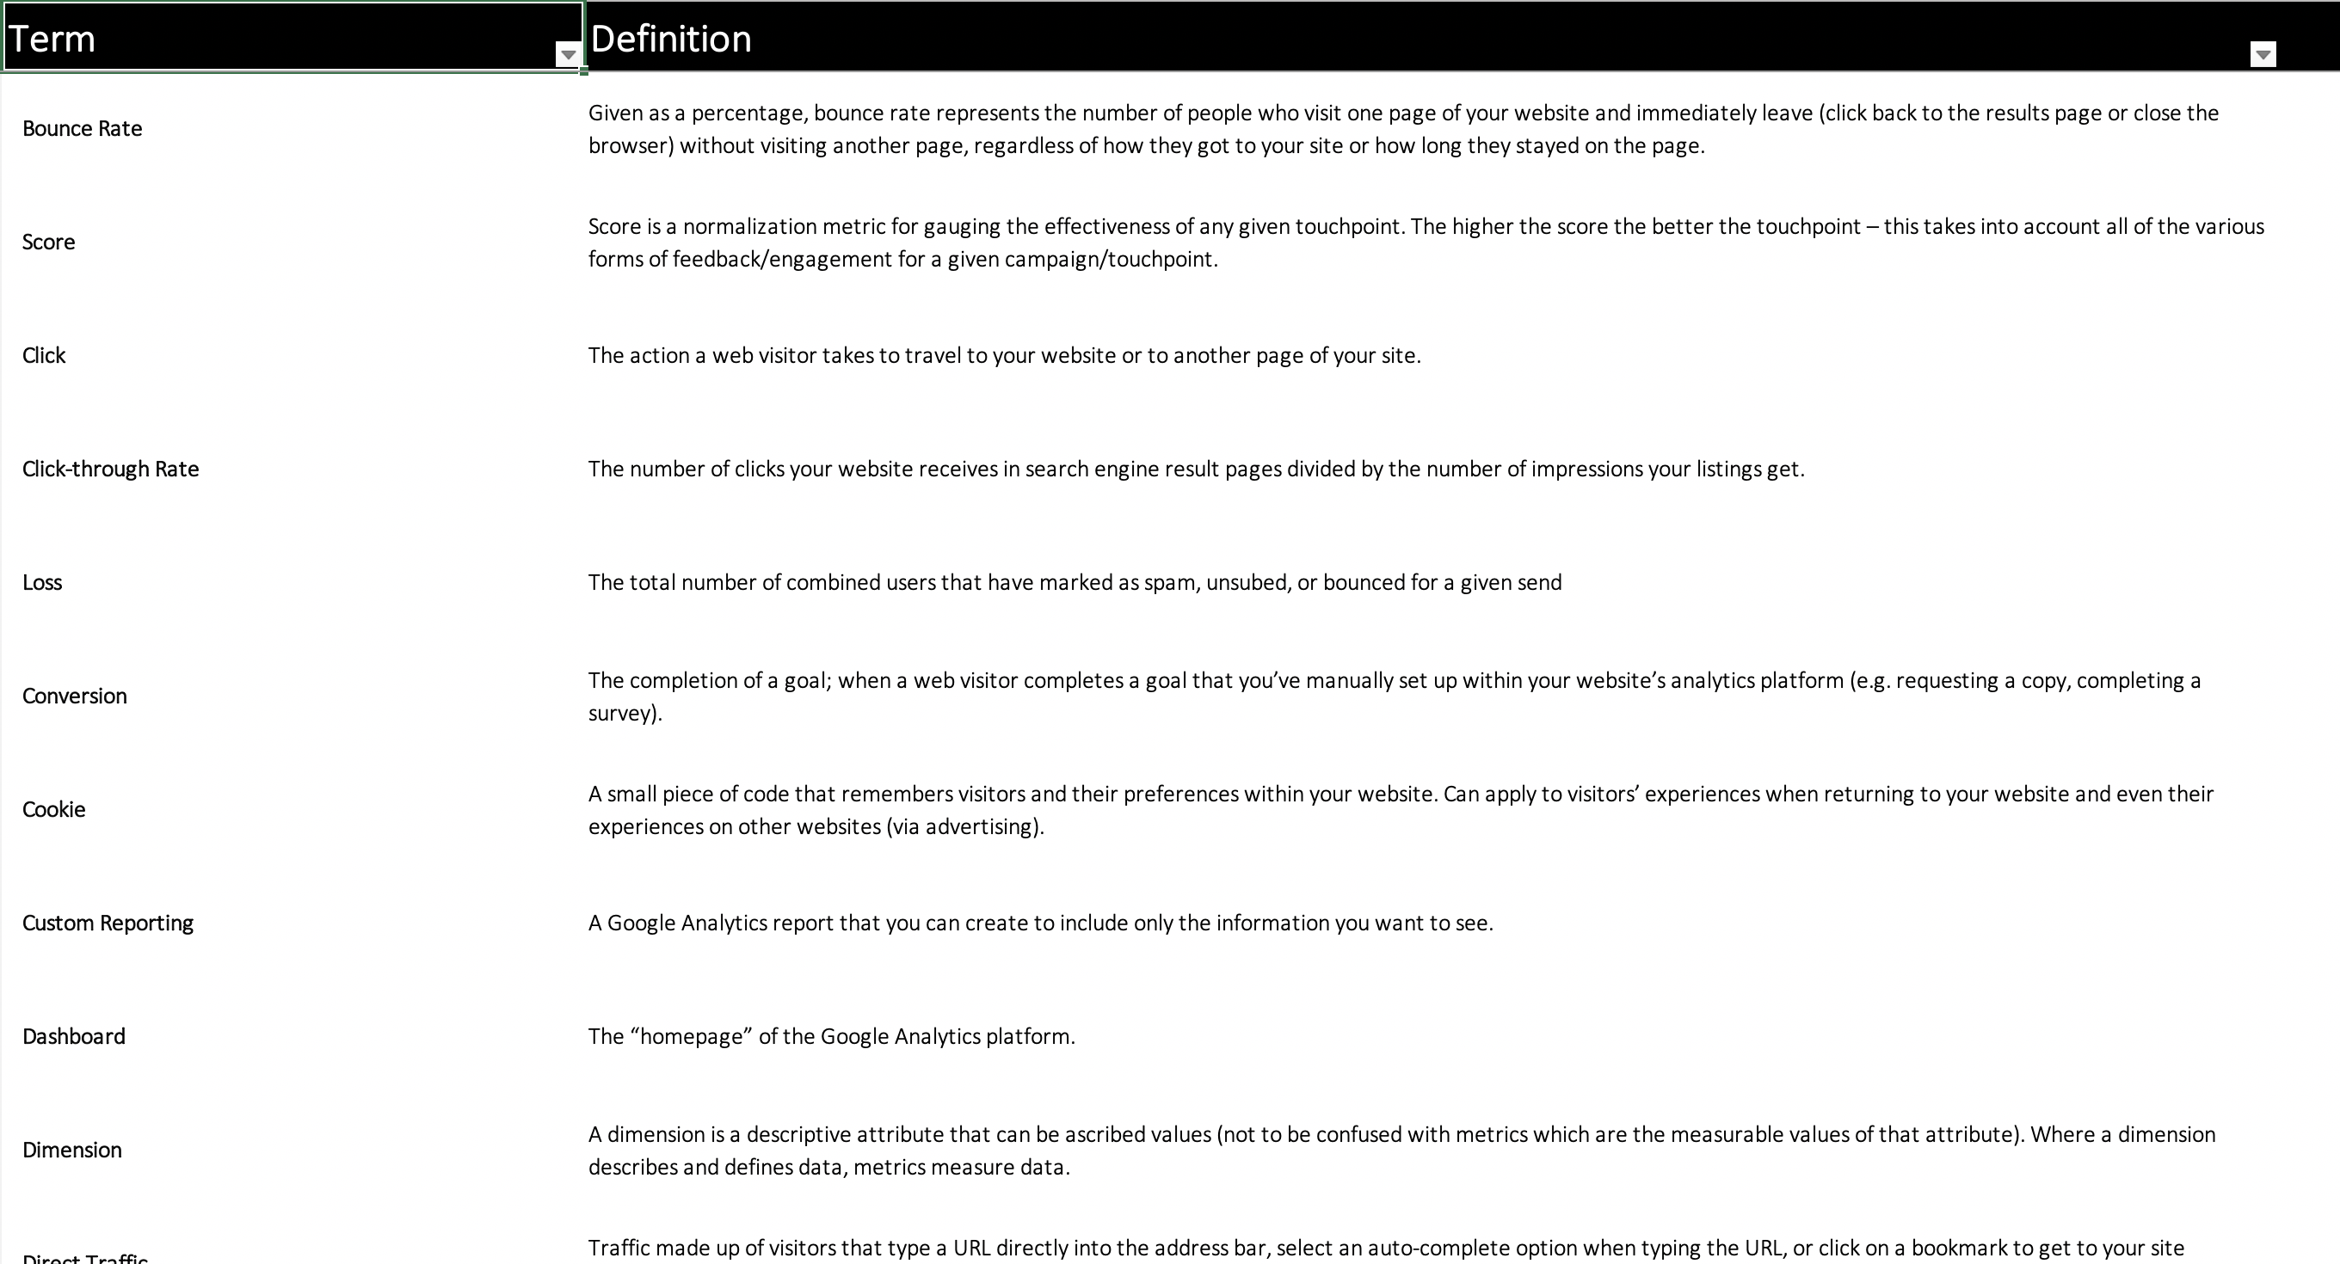

Slide 47
